Slide 1
Status Report #13
Item
2020. Jan 31 (Fri)
Tomomasa FUJIWARA
ToF: cosmic ray data
New circuit design
Beamtime data analysis
Writing Final-term report

Slide 2
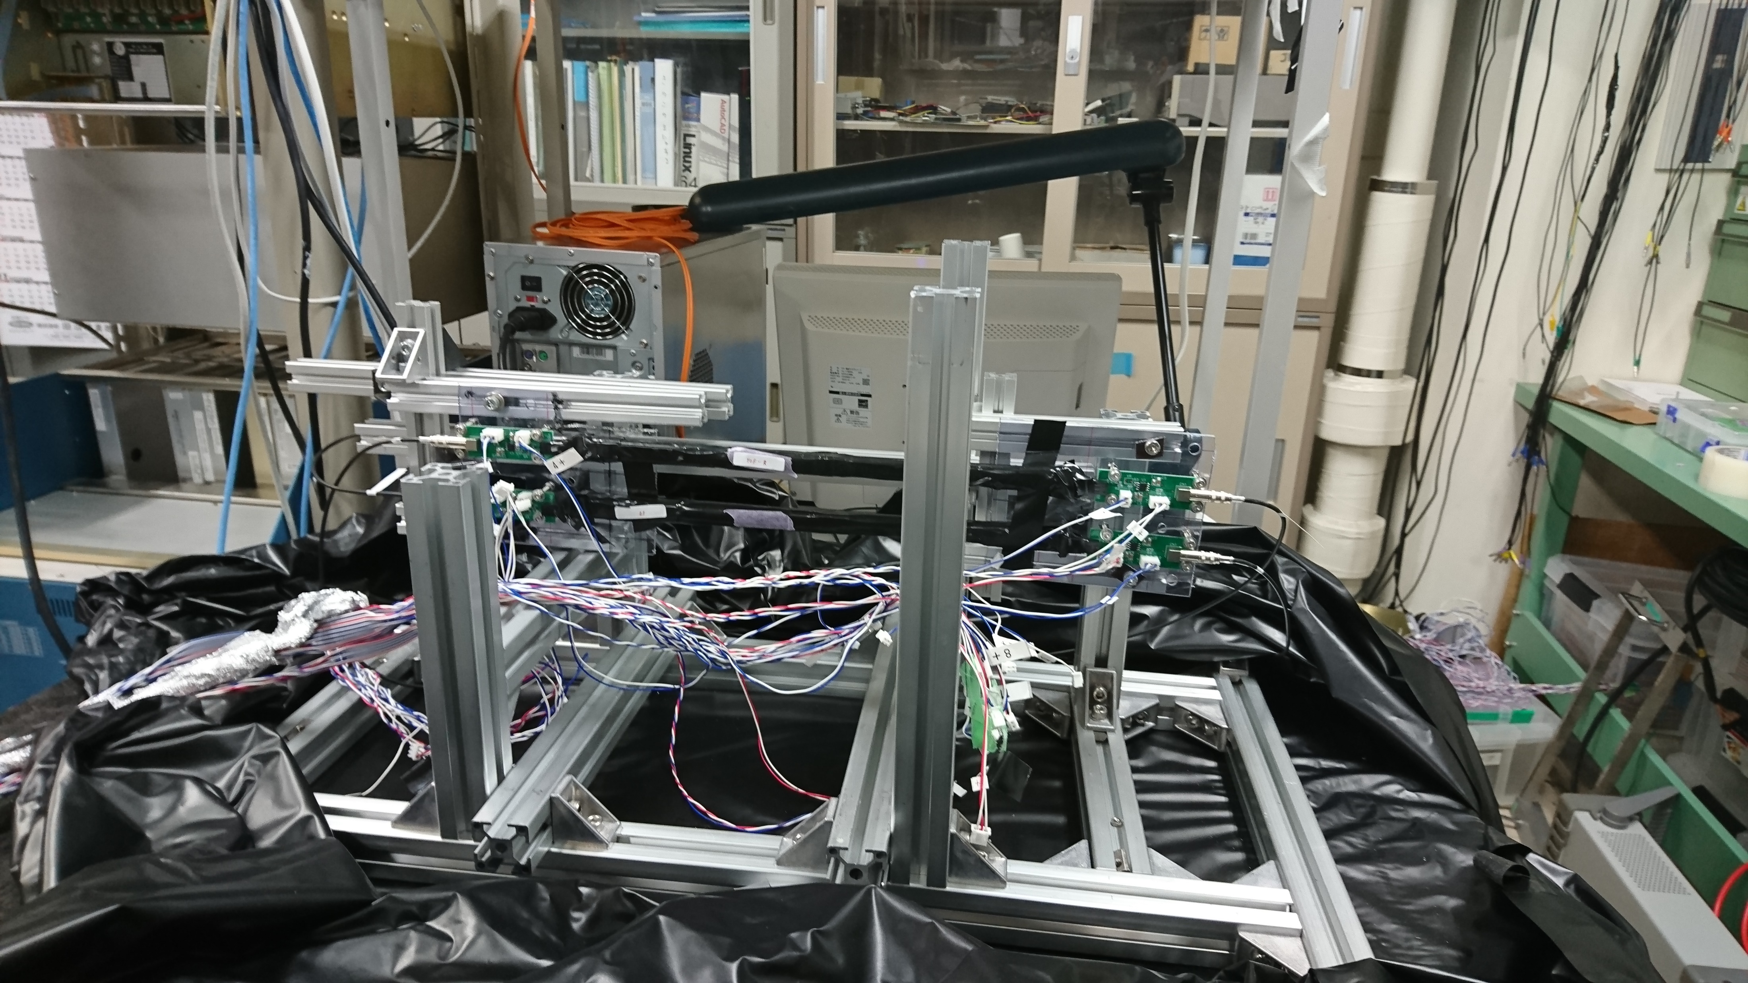
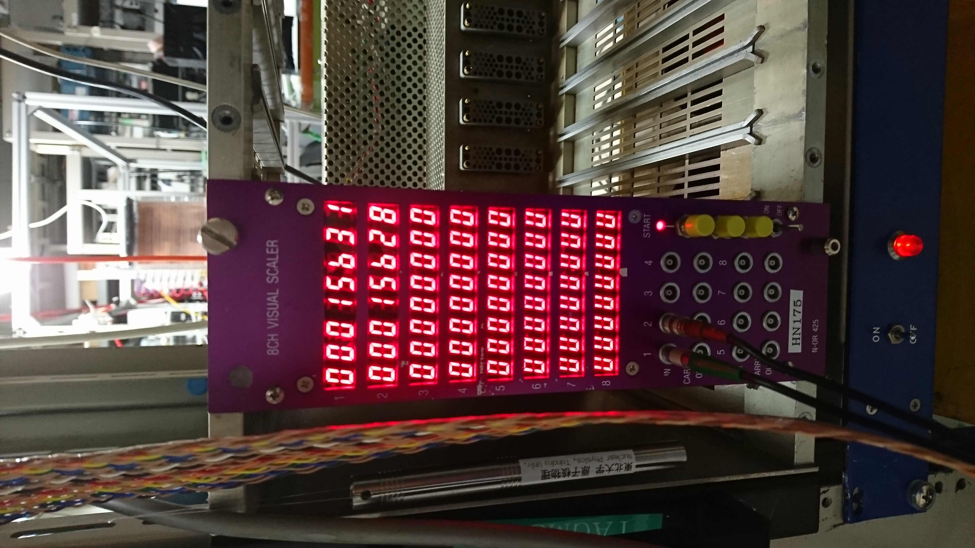
ToF: Cosmic ray
Purpose
Check consistency with data at ELPH
Setup
Bias voltage Vb: 44.7V
Threshold(R1, R2, L1, L2): -58.2, -35.2, -78.6, -51.4
→ decided to avoid noise by checking on oscilloscope
Start: 2020/01/22 19:14
Taken Event: ~7000/day by scaler and PC display
Stop: 2020/01/27 18:55
Accident (やらかしました...)
There were 2 DAQ running at the same time....
On scaler ~ 38000 events, DAQ stopped at ~15689 ....
R1
ToF - R
R2
L1
ToF - L
L2
→
2020/01/24 19:16
Request
Accept

Slide 3
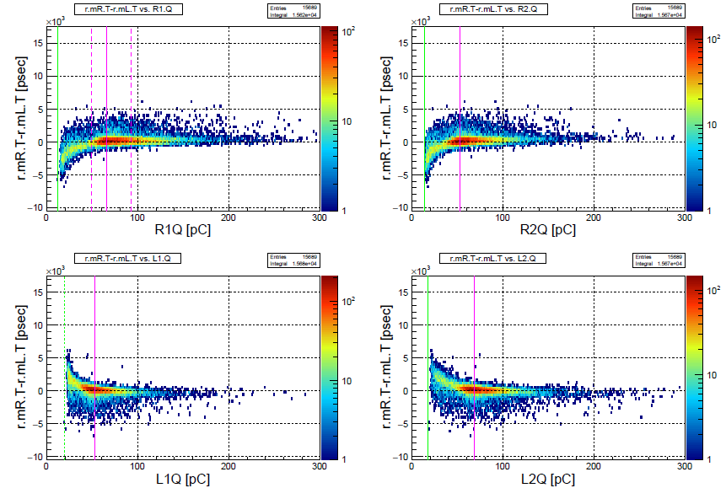
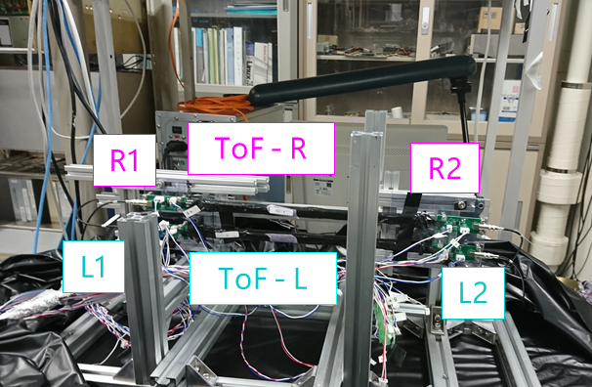
ToF: Cosmic ray
Result -brief-
mean of R.TDC - mean of L.TDC
vs. QDC of each MPPC
Notation:
r: raw (no TWC)
d: after TWC
m: mean of 1 & 2
R: ToF-R
L: ToF-L
T: TDC
Q: QDC

Slide 4
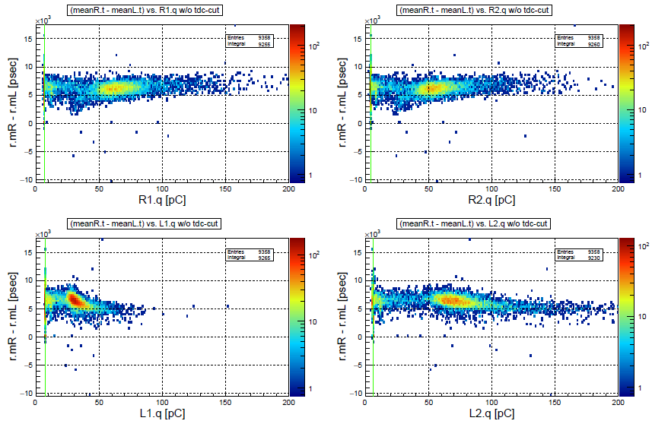
ToF: Cosmic ray
Comparison: cosmic vs. beam
⇓This time (cosmic)
⇓Data at ELPH (beam) : run0177 (Vb = 44.7V)

Slide 5
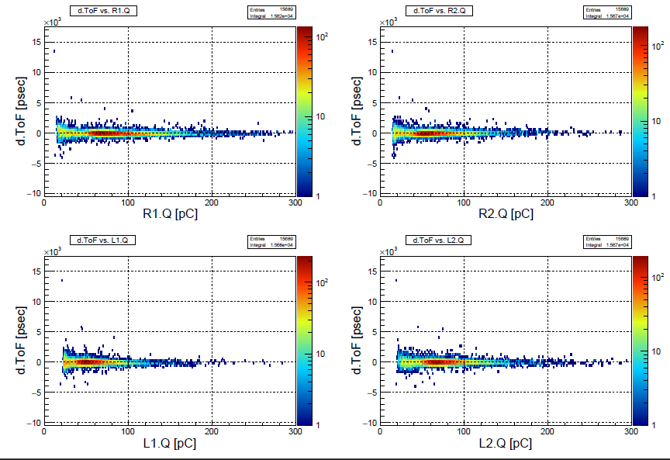
ToF: Cosmic ray
Time walk correction
⇓ Before
⇓ After

Slide 6
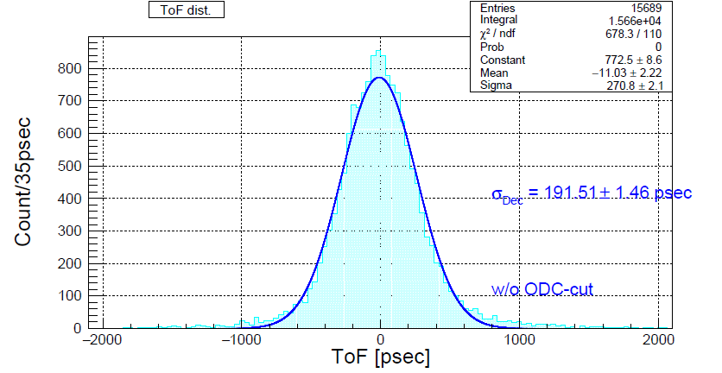
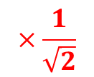
ToF: Cosmic ray
ToF hist.
$$×\frac{1}{\sqrt{2}}$$

Slide 7
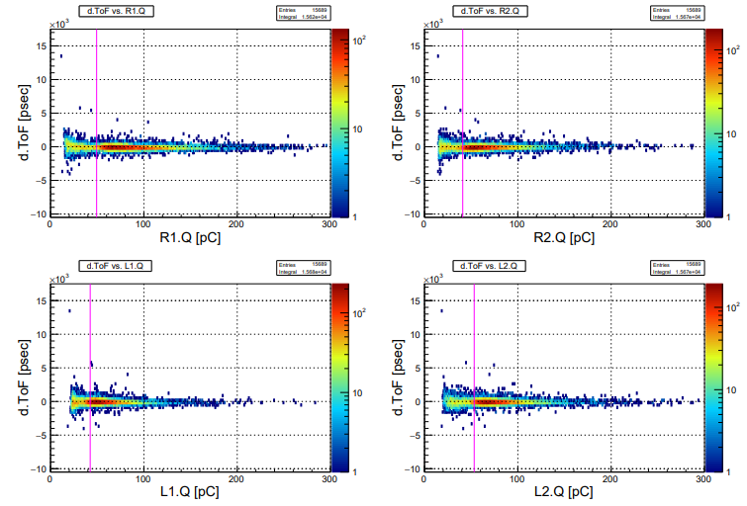
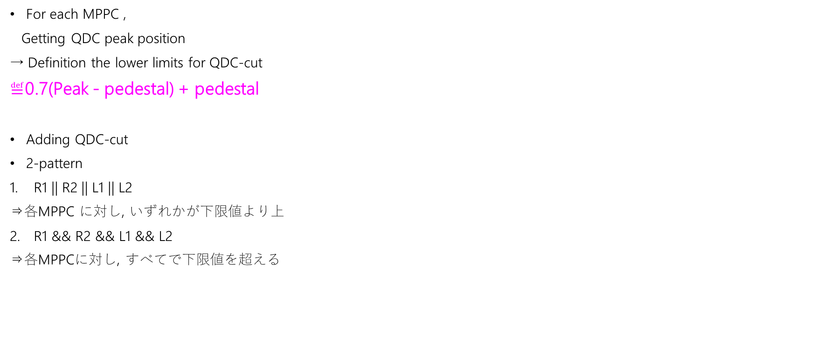
ToF: Cosmic ray
For each MPPC ,
Getting QDC peak position
→ Definition the lower limits for QDC-cut
$≝$0.7(Peak - pedestal) + pedestal
Adding QDC-cut
2-pattern
R1 || R2 || L1 || L2
⇒各MPPC に対し, いずれかが下限値より上
R1 && R2 && L1 && L2
⇒各MPPCに対し, すべてで下限値を超える

Slide 8
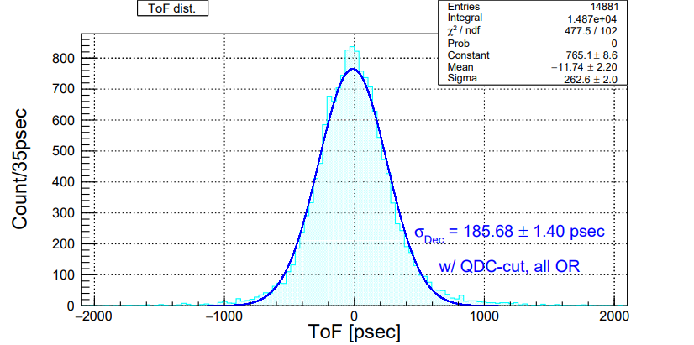
ToF: Cosmic ray
Pattern: 1 All OR

Slide 9
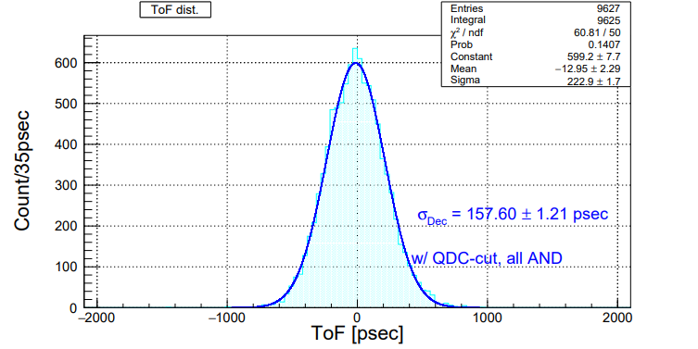
ToF: Cosmic ray
Pattern: 2 All AND
??

Slide 10
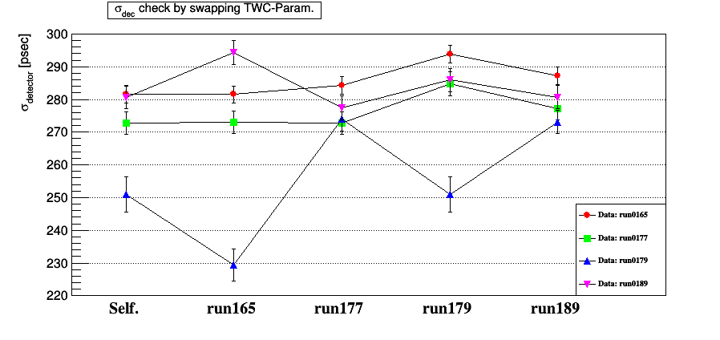
Beam time data analysis
Checked run summary between run0177 to 0179
*Hall access
→but ToF not touched...
*Vb (Bias) was not changed
*Beam stopped ~30min
Checked number of event
run number | size (before TDC cut) | size (After TDC cut)
165 | 18662 | 6768
177 | 11000 | 3863
179 | 11456 | 1779
189 | 11577 | 5322

Slide 11
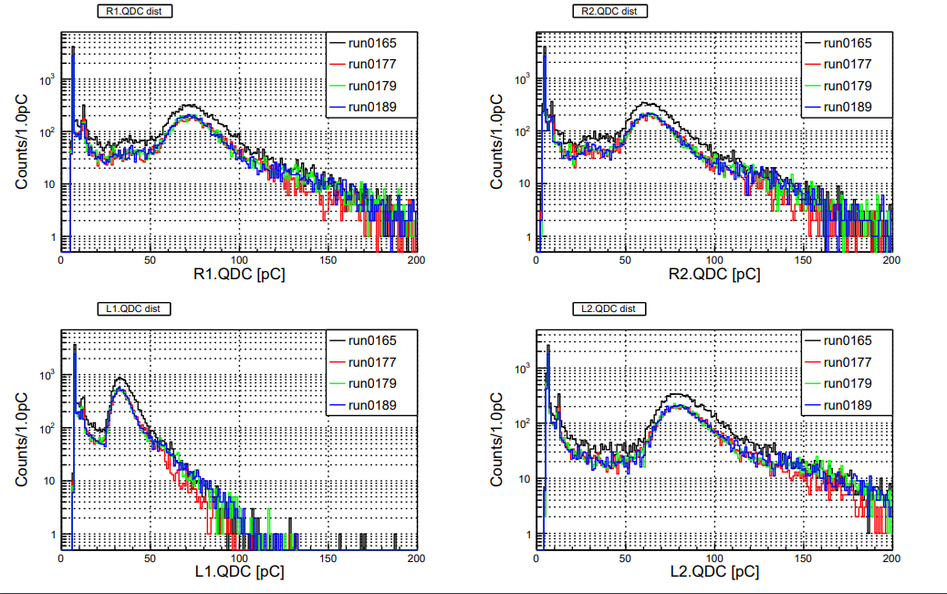
Beam time data analysis
QDC for each MPPC

Slide 12
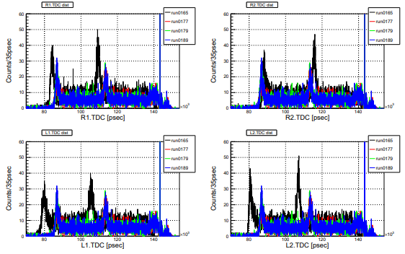
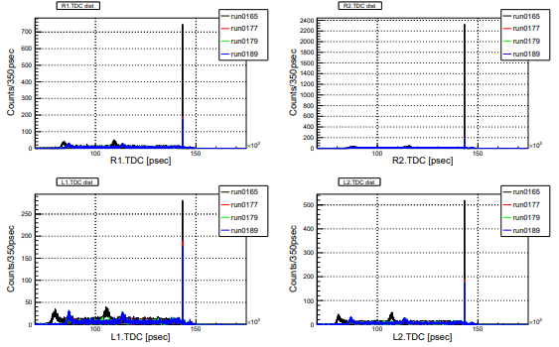
Beam time data analysis
TDC for each MPPC

Slide 13
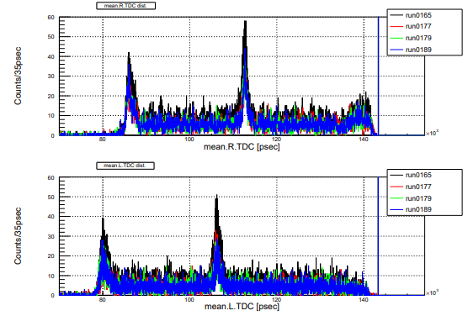
Beam time data analysis
mean of TDC hist for R & L
Shifted positions of peak
from run0165 to other
⇒Effect of threshold changed ??
⇒ Why run0177 shifted?

Slide 14
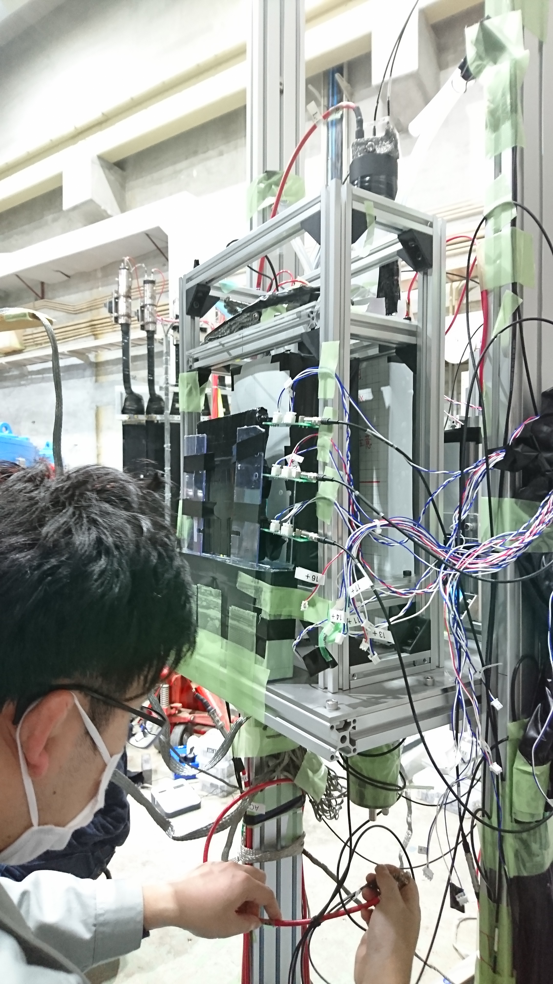
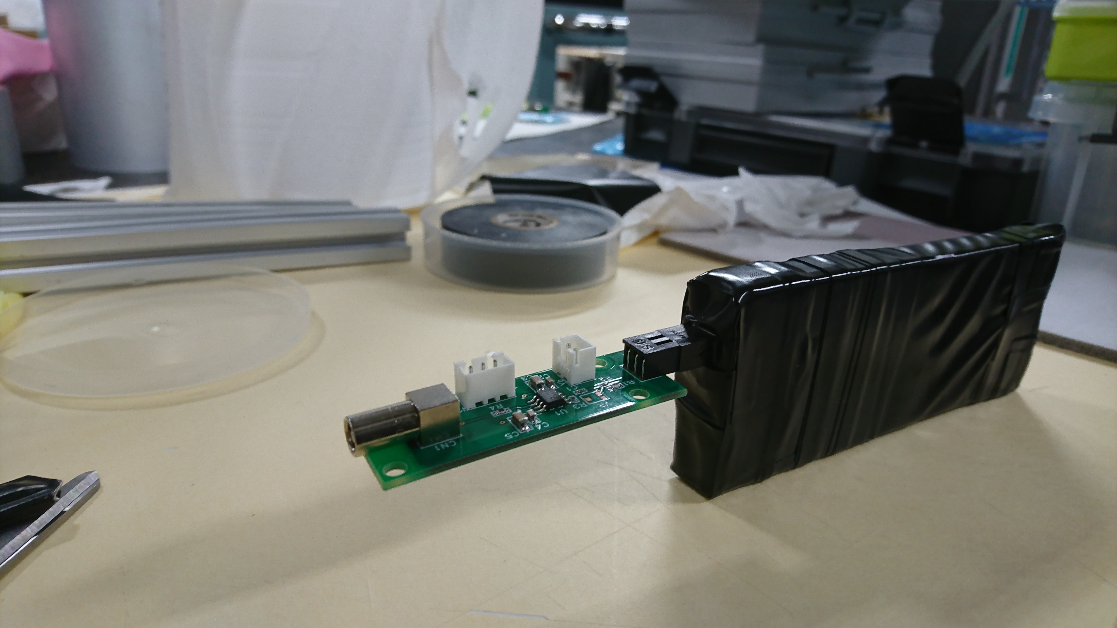
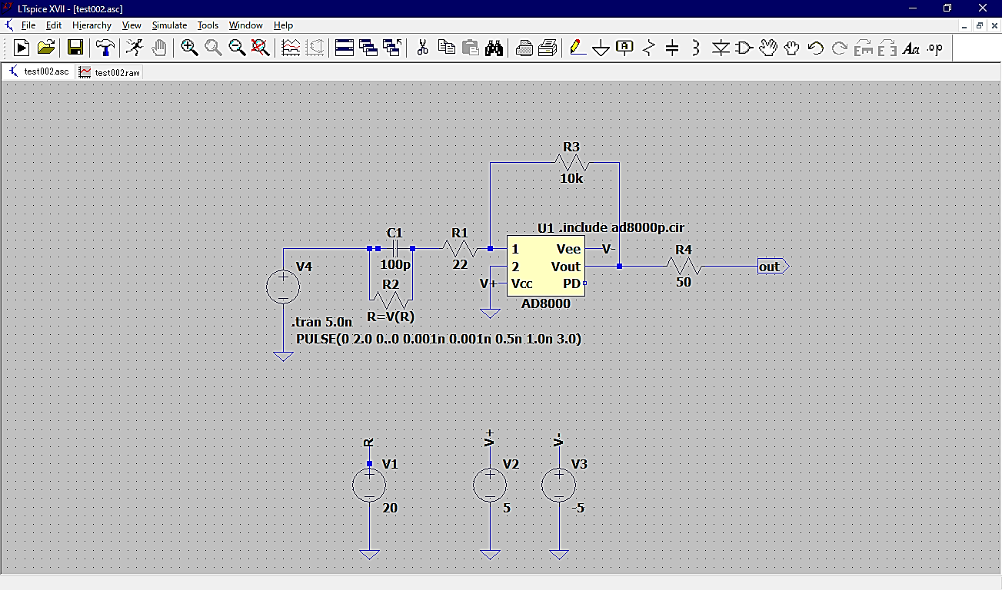
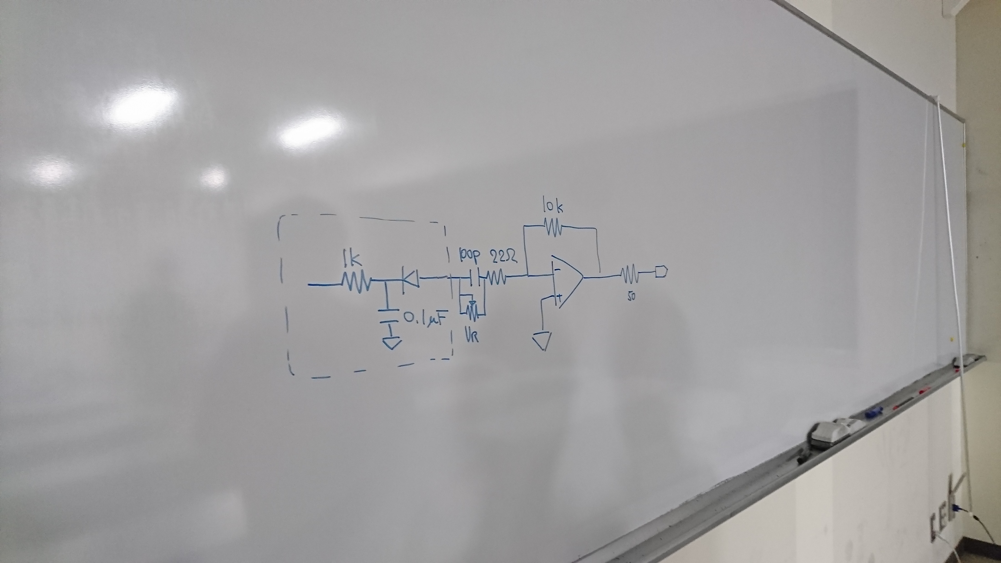
New (?) circuit design
Circuit for MPPC
MPPC & board between amp circuit
⇒ connected with only connecter
⇒ Unstable
Necessary for new circuit
Start leaning CAD
Installed application for design circuit diagram (CADLUS circuit, CADLUS X) and simulation tool (LT Spice)
Now: learning how to draw circuit diagram
Draw with ‘LT Spice’
Practice theme
from Nagao-san

Slide 15
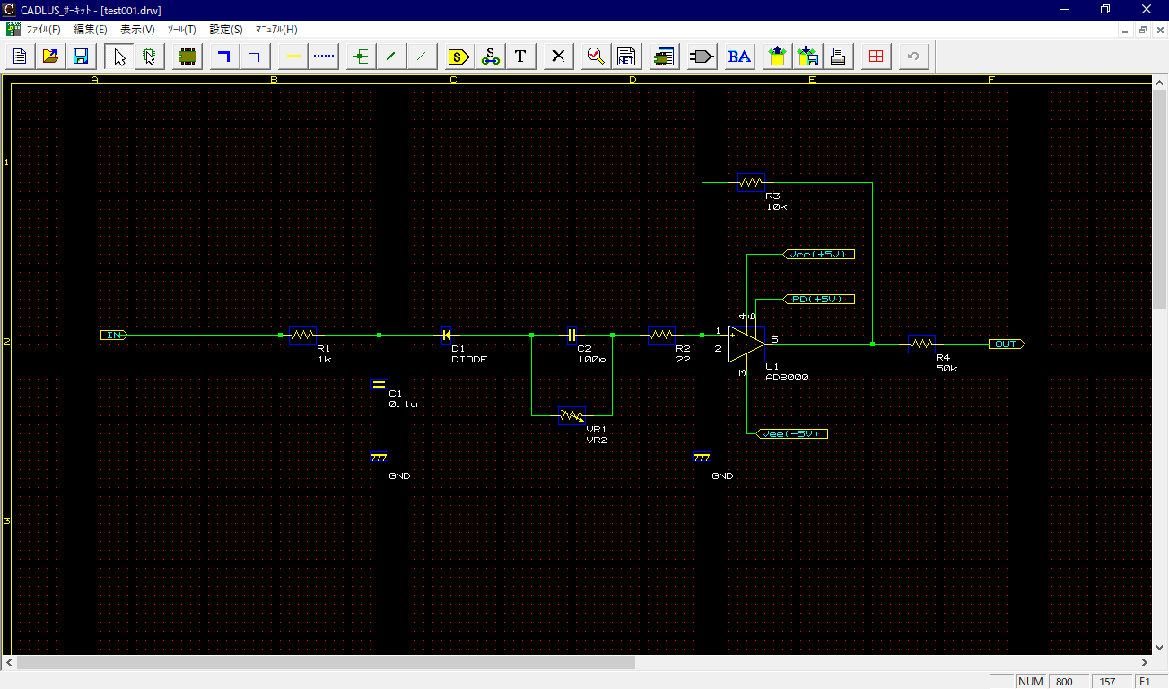
New (?) circuit design
On progress
Draw on
CADLUS circuit

Slide 16
To do next
Learning how to draw body wiring diagram
Preparation for 卒研発表 ⇒ make presentation

Slide 17
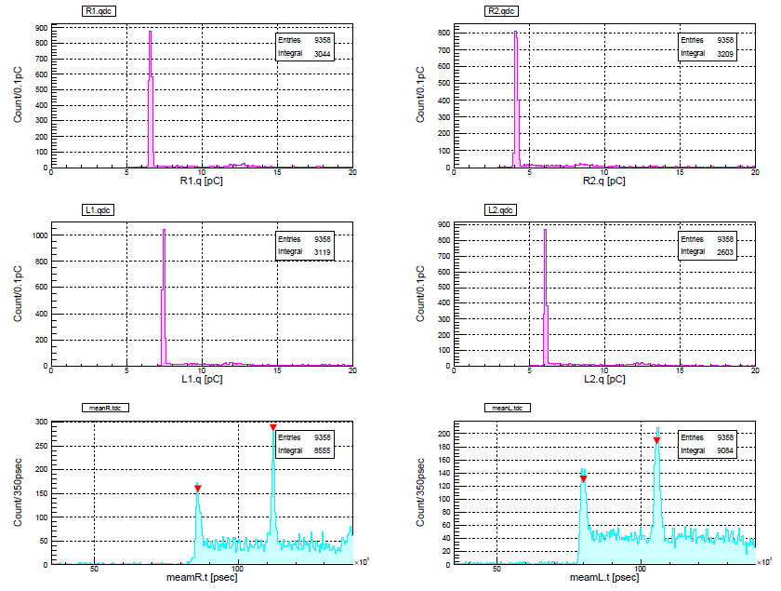
run. 176 pedestal & TDC-peak

Slide 18
run. 176
raw.ToF vs. QDCs

Slide 19
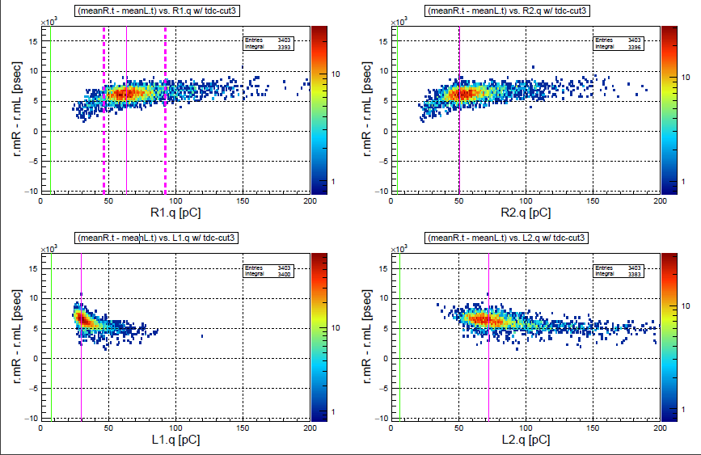
run. 176
ToF vs. QDCs
After TDC-cut

Slide 20
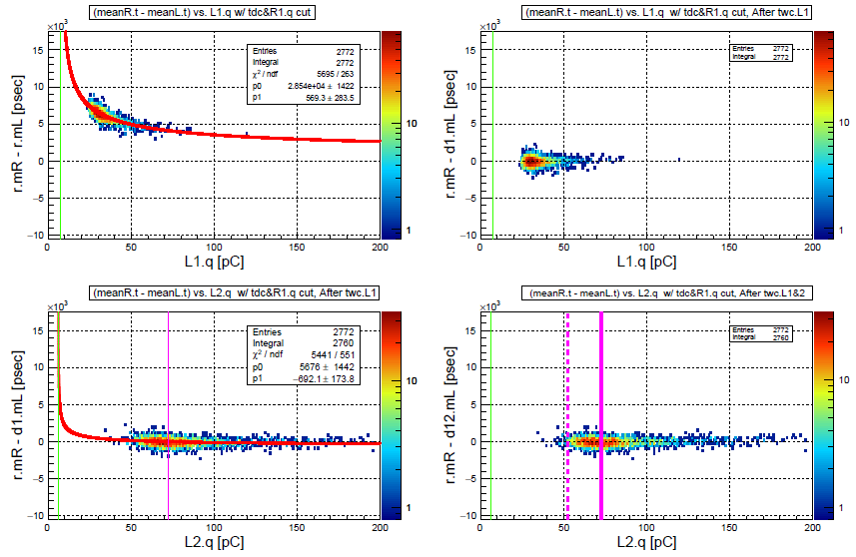
run. 176

Slide 21
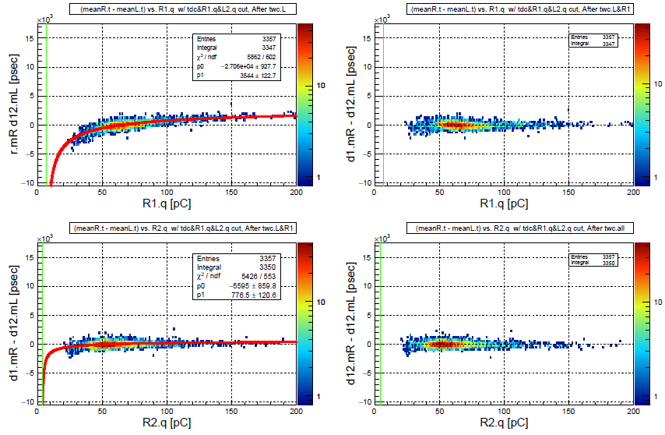
run. 176

Slide 22
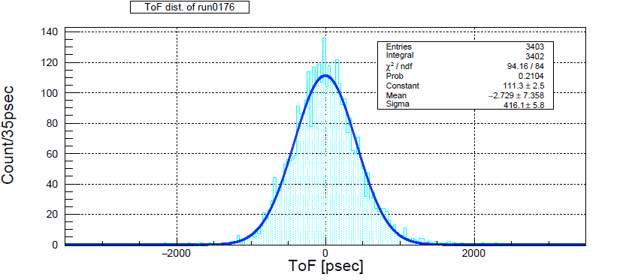
run. 176

Slide 23
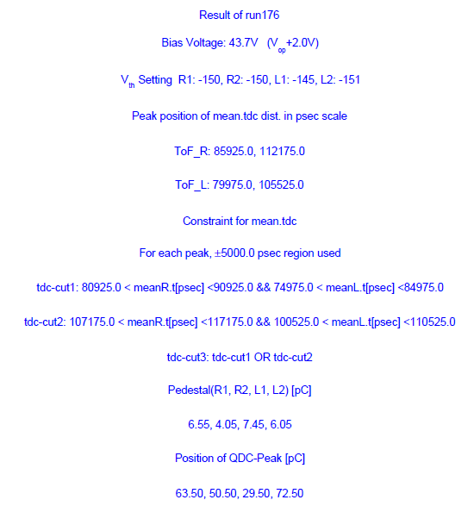
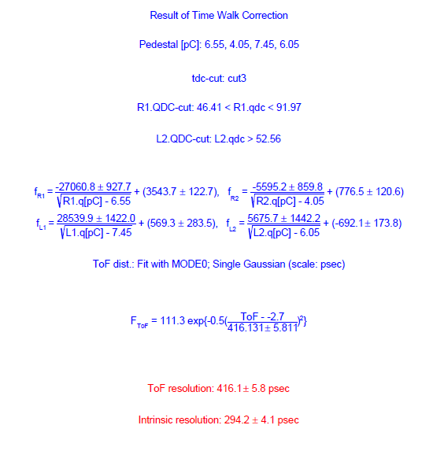
run. 176

Slide 24
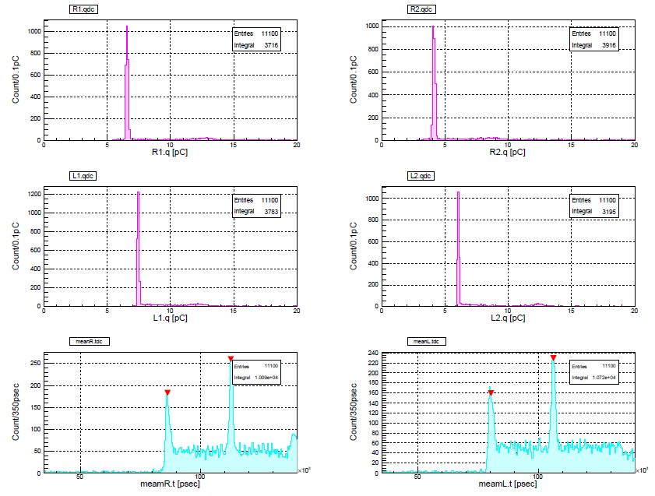
run. 177

Slide 25
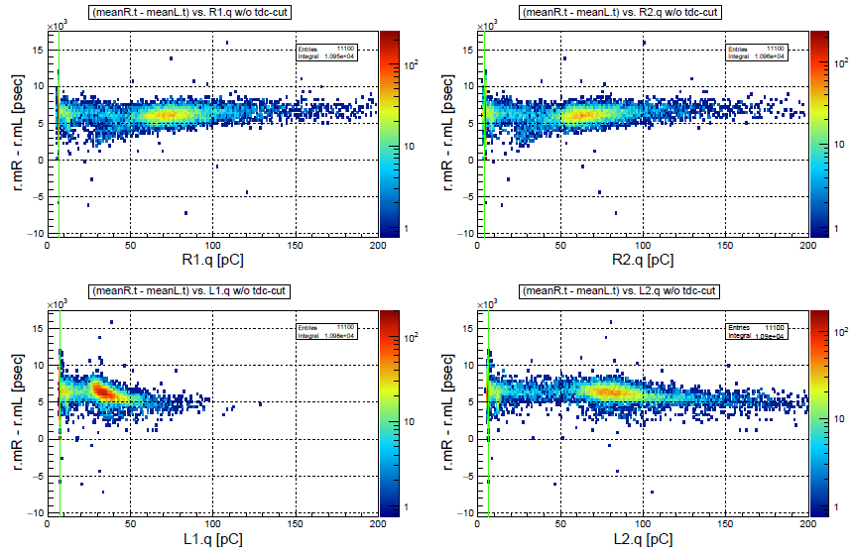
run. 177

Slide 26
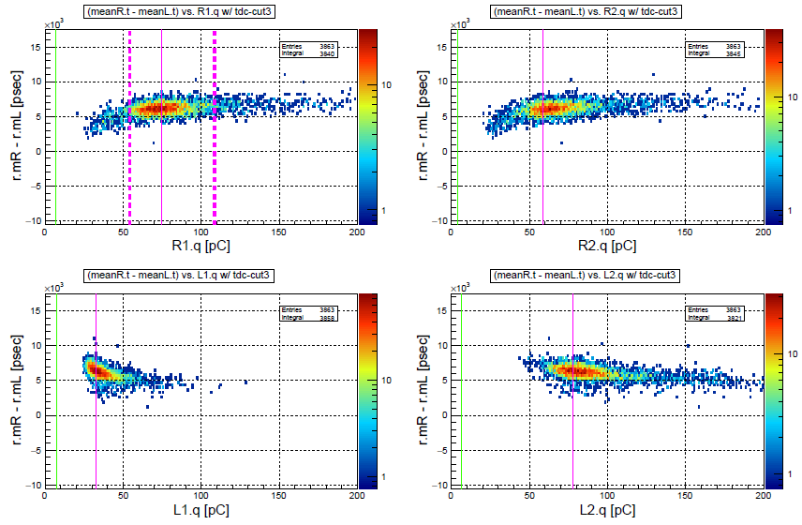
run. 177

Slide 27
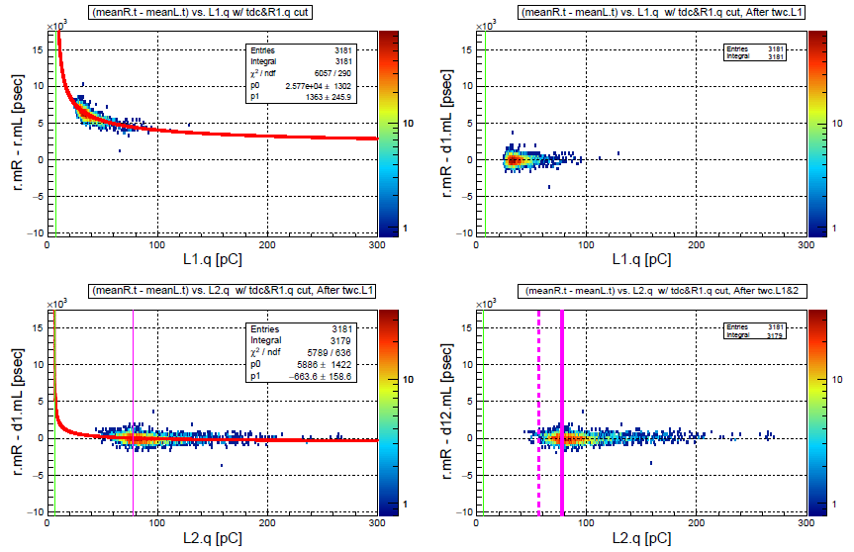
run. 177

Slide 28
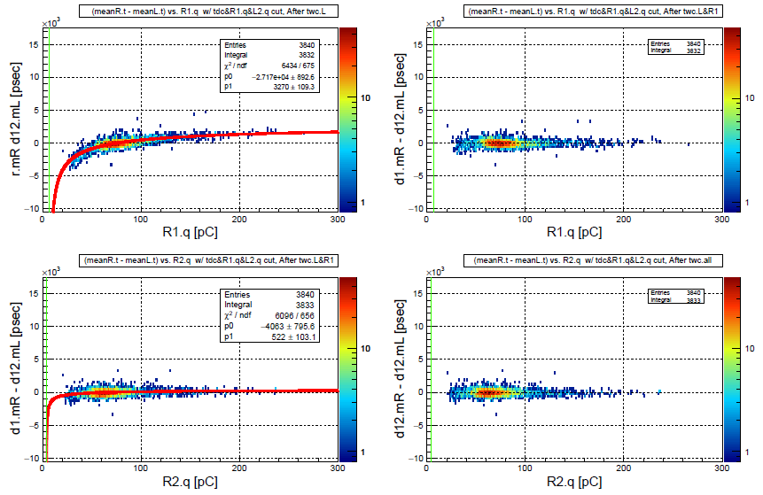
run. 177

Slide 29
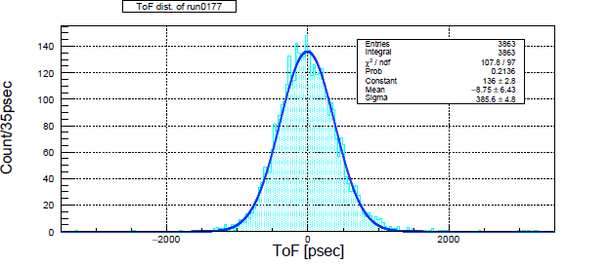
run. 177

Slide 30
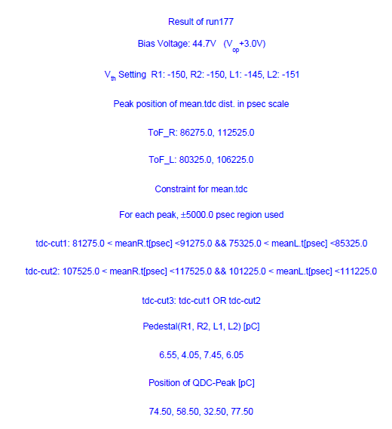
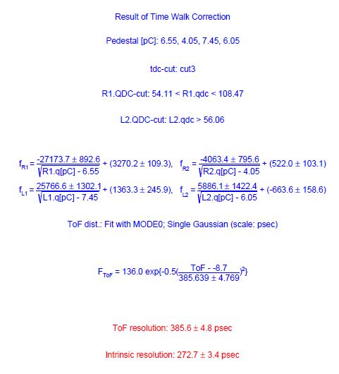
run. 177

Slide 32
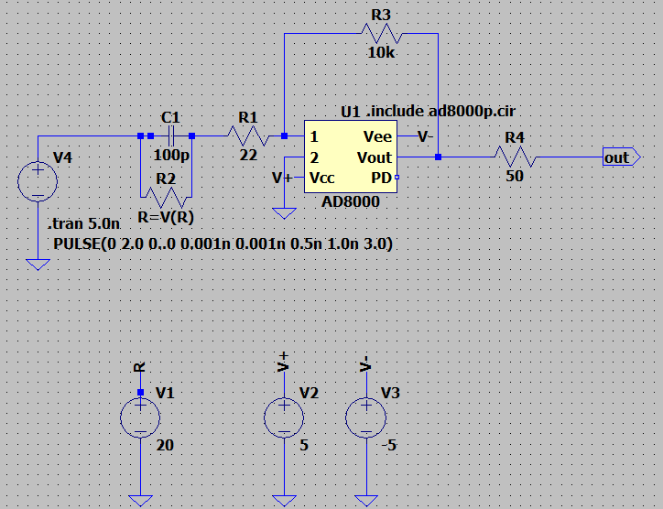
Simulation for circuit
今後のToFの使うための新しい回路の設計を始めた

Slide 33
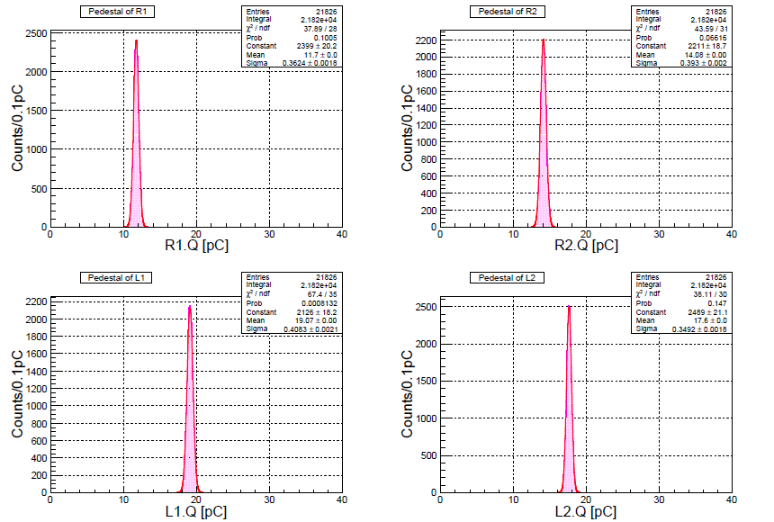
宇宙線測定 解析結果
*ペデスタルの取得

Slide 34
生の上下のTDC meanの差
vs. 各MPPCのQDC 相関

Slide 35
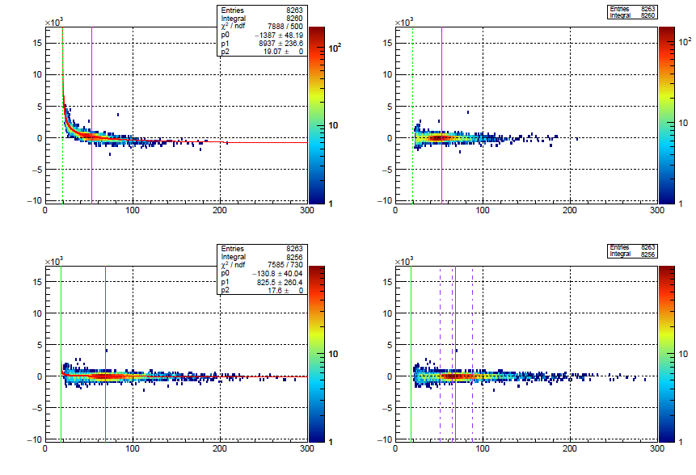
L1 & L2 に対する Time walk correction

Slide 36
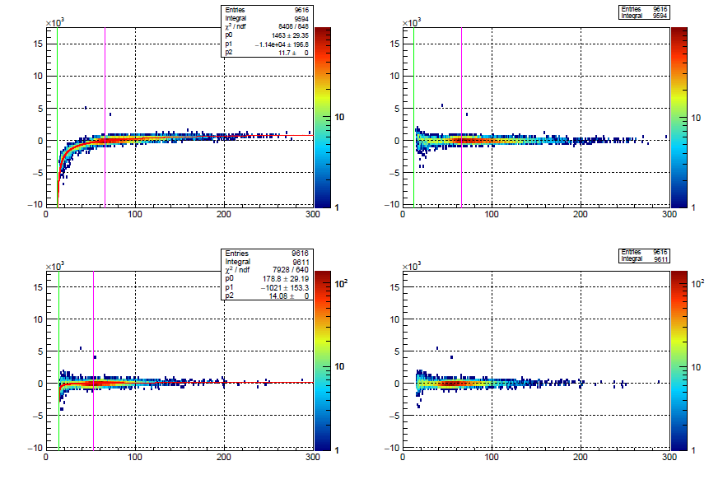
R1 & R2 に対する Time walk correction

Slide 37
全MPPC に対しての
Time walk correction 後の
ToF vs. QDCs 相関

Slide 39
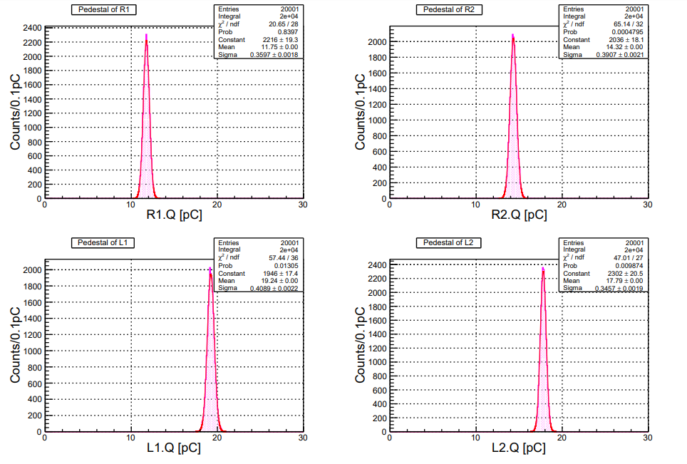

Slide 40
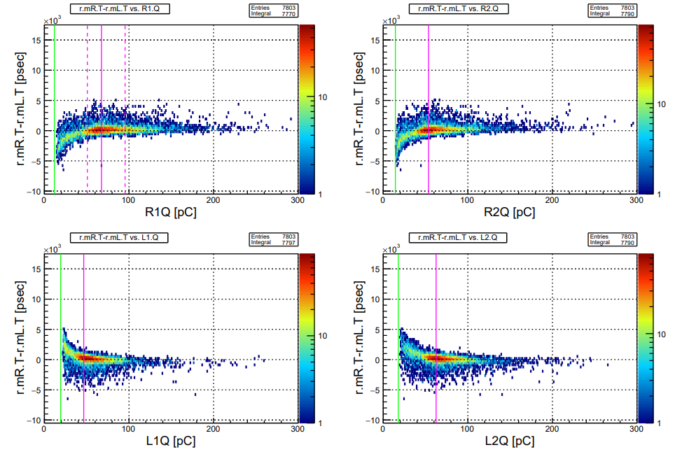

Slide 41
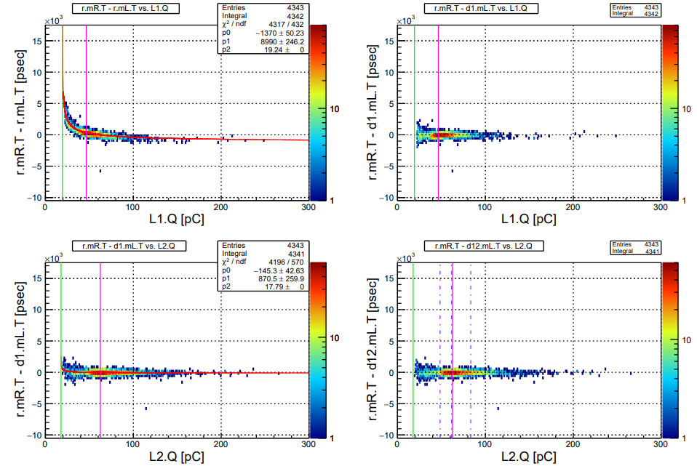

Slide 42
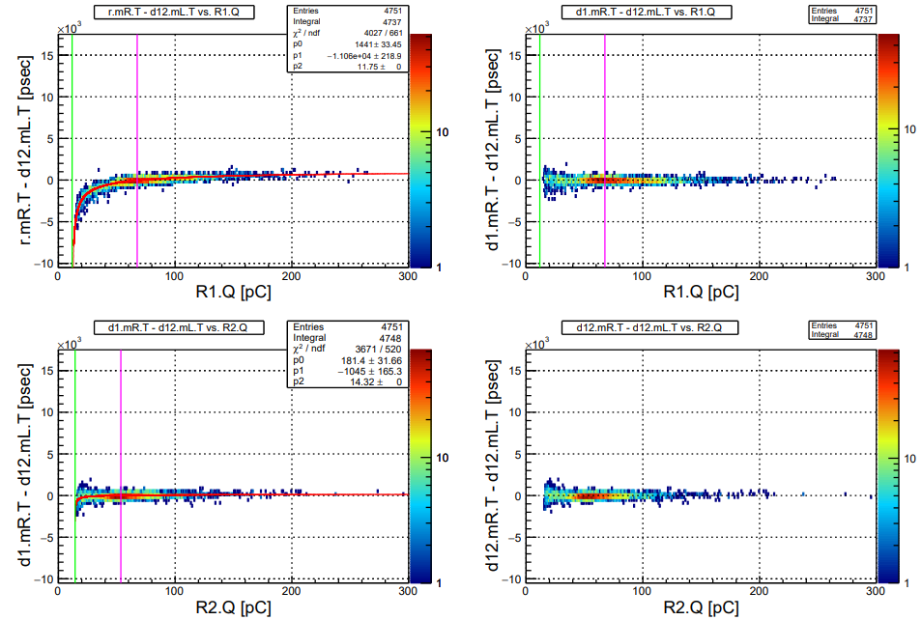

Slide 43
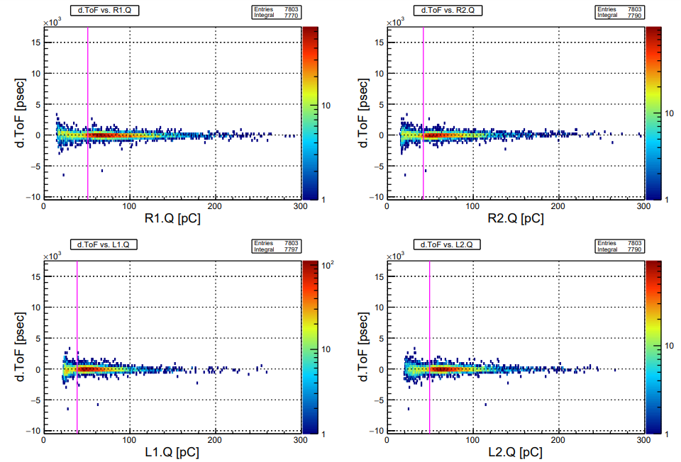

Slide 44
